Slide 1
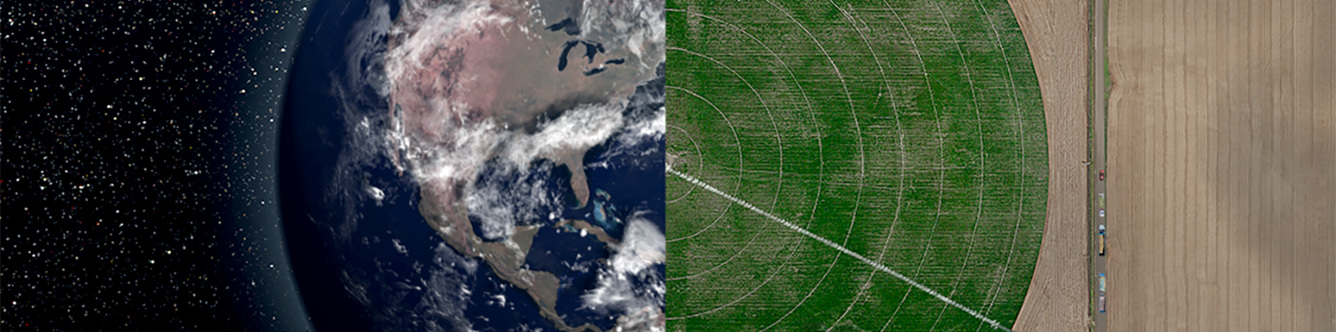
How High is Your Supply?
Estimating Field-Level Greenhouse Gas Emissions Across the Continental United States via Remote Sensing and Machine Learning
Jay Weeks, Nathan Basch, Jyoti Shankar, A.J. Kumar
December 2023
Notes:
Morning everybody, thanks for joining me here in this session. It’s an honor to present along with all of these other fantastic projects. My name is Jay Weeks. I am a data and soil scientist with Indigo Ag and today I am going to share with you a little information about agricultural supply-shed emissions and how we are using machine learning to reduce them.

Slide 2


Brands are publicly committing to reducing their environmental footprints. Net-zero emissions are achievable through internal emissions mitigation, offsets, and supply chain improvements.
Scope 3
Companies that have committed to net zero with SBTi need to reduce their total footprint by 90%* by 2050 at the latest. Offsets cannot count towards this reduction pathway.
90%
Greenhouse Gas Emissions
(or tonnes of Carbon Equivalent)
Offsets may be used to achieve a net-zero state in the target year to neutralize residual emissions (up to 10% of the base year footprint).
10%
Scope 3 Emission Reductions
Scope 2
Supply Chain Emissions
Scope 1 & 2 Emission Reductions
Scope 1
Purchased Electricity
Internal Emissions
Purchase of Carbon Credits
Notes:
Over the last several years, many large brands that you will be familiar with are publicly committing to reducing their environmental footprints.
Because, as you can imagine, greenhouse gas emissions stem from a wide variety sources often classified as “scopes,” one method alone is not sufficient to meet this goal
If you were to look at the breakdown of a typical consumer packaged goods brand, you might see something that looks similar to what is before you.
For example, for a company making corn chips, scopes 1 & 2 would be the emissions associated with the manufacturing of the corn chip, while scope 3 would pertain to emissions resulting from producing the raw materials, such as the growing of the corn.
It is very common for scope 3 emissions or emissions coming from a company’s supply chain to compose the largest portion of a company’s total emissions footprint
Indigo serves as a partner on this journey by offering programs to both reduce scope 3 emissions and offset the remaining emissions that may result from the process with carbon credits.
This presentation will focus on scope 3 quantification and reduction modeling associated with our Source programs.

Slide 3
Supply chain improvement requires reliable methods to quantify scope 3 greenhouse gas emissions.
Net GHG Reduction Potential from Agriculture (2030)
Modelling agricultural emissions is challenging:
Fields are inherently heterogeneous, complex ecosystems with many physical, biological, and chemical interactions.
Biogeochemical process models are relatively accurate but data-hungry and computationally intensive to run.
Field-level, ground-truth information is costly to collect.
Public data is limited and often too aggregated based on political boundaries to be useful for field-level inference.
Remote sensing is a powerful tool, but only some operations are inferable and at relatively coarse resolution.
Billion tonnes CO₂-eq per year
Abatement
(reduction)
Sequestration
(removal)
Total
So how can we get emissions estimates at scale?
Source: IPCC Sixth Assessment Report (AR6), Working Group III: Mitigation of Climate Change, Figure SPM.7
Notes:
With the rise of public commitments comes the necessity for reliable methods of scope three emissions quantification.
We know that agriculture has tremendous potential to contribute to greenhouse gas reduction as can be seen in this this figure from the IPCC sixth assessment report.
However, modeling agricultural emissions is challenging.
Fields are inherently highly heterogeneous, complex ecosystems with many physical, biological, and chemical interactions.
Biogeochemical process models like DAYCENT or DNDC do exist and can model a number of these systems, but they often require tremendous amounts of data and computational power to run.
And even with the models, collecting the specific field or management zone-level information from famers is costly and impossible to do for every farm on the planet.
Public data is useful, but it only provides higher level insights based on aggregated survey responses that may obscure the diversity of management approaches across large areas. For example, in a state like Kansas with a climate the changes significantly from the drier west to the wetter east, state-level averages for information like nitrogen fertilizer application rates are of marginal utility.
Remote sensing is emerging as a powerful tool for field-level analysis, but it too can only take our understanding so far. Emissions sensitive variables, like irrigation, can be detected in the binary, irrigated or not, leaving information such as how much water was applied to be determined by other means.

Slide 4
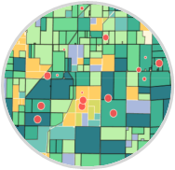
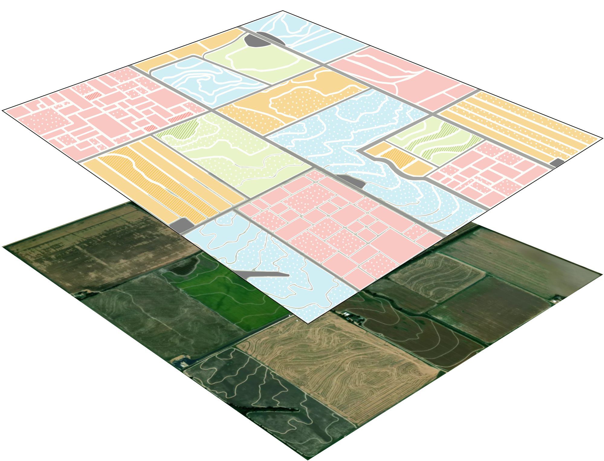
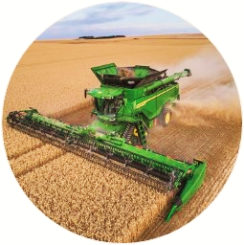
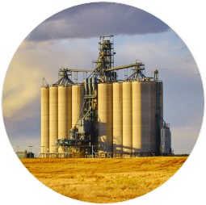
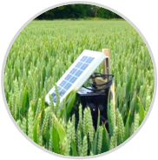
We surmount these challenges by using proprietary technology, field experiment results, partner data and feedback loops.
Remote Sensing Data
Satellite and remote sensor observations
On Farm Data
Growers’ intentions, machine data, sensor data, and soil samples
Transactional & Markets Data
Local supply, demand, and price intelligence
Field Experiment Data
Genetic sequence and yield data
Indigo Data Platform
Data science, soil science and technology platform built for agriculture
Notes:
Indigo is unique and fortunate to have a wide array of assets it can leverage to understand what is happening on any given field.
I like to think of our data ecosystem as a set of nested layers:
At the base sits public data like soil information from SSURGO,
On top of that we can use remote sensing observations to build a coarse scaffold of management information. Was the field irrigated, tilled, cover cropped, etc.?
Then add in on-farm and experimental data to refine our understanding of regional practices and outcomes. For example, if the field was tilled, what kinds of implements were likely used.
And finally, our market data is mixed in to further contextualize economic behavior and track grain flows.

Slide 5
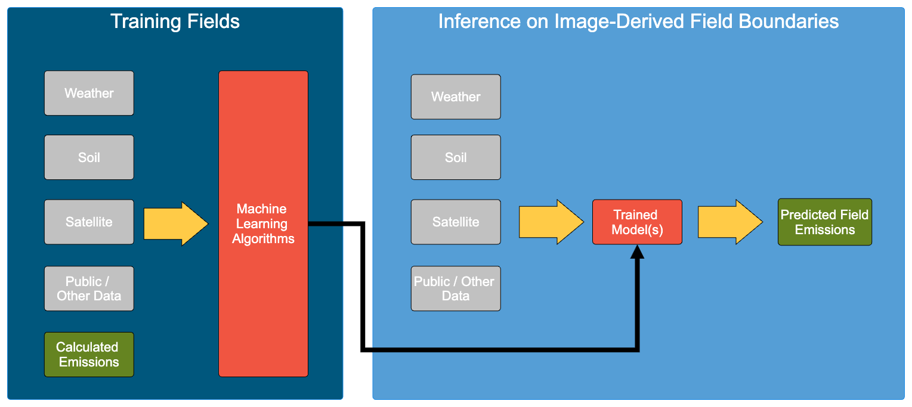
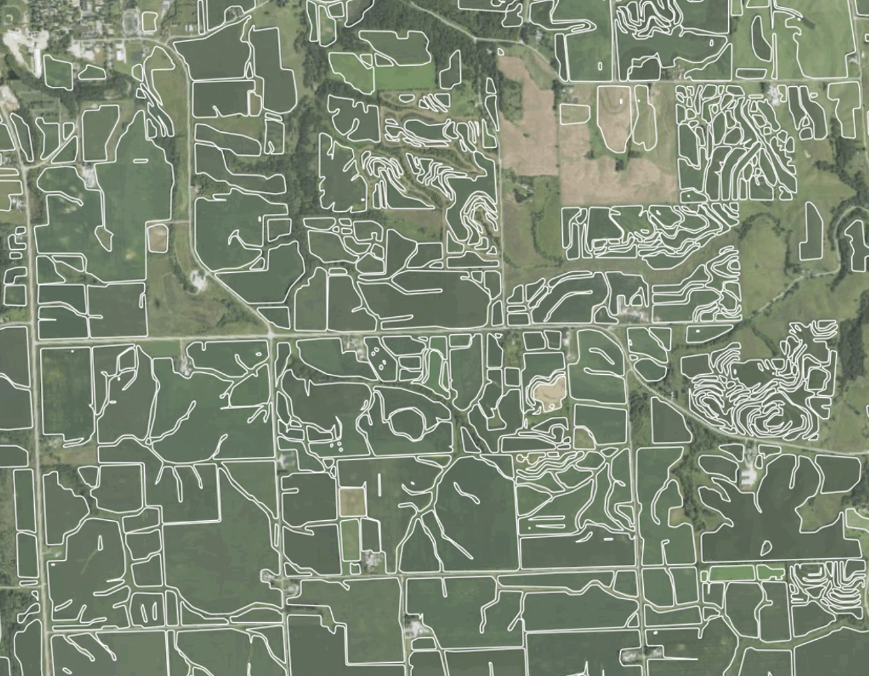
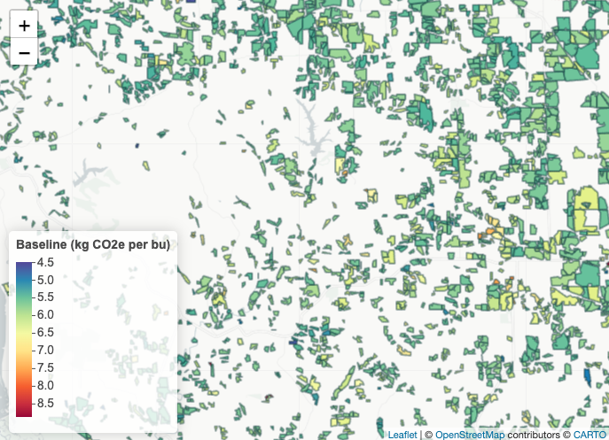
Public data and Indigo’s assets are fused and combined with machine learning techniques to estimate field-scale emissions.
Notes:
Our modelling process can be broken into two main steps, training and interference.
In the training step, we identify the highest quality field information that we have and fuse all of our data assets together.
We then run that dataset through our foundational model suite (including models like DAYCENT) to arrive at the most accurate assessment of emissions from each of the training field management cycles.
This gives us field and management info + emissions.
From there we use a variety of machine learning techniques to train models to estimate the emissions of fields using subset of the data that we have that is available at scale.
This is data like weather, soil info, remote sensing, etc.
After undergoing a series of validation measures, we take a set of image-derived boundaries for the region of interest built by our remote sensing team, such as those seen here, combine those with the “at scale” data and run them through the trained models to arrive at the field-scale emissions predictions.

Slide 6
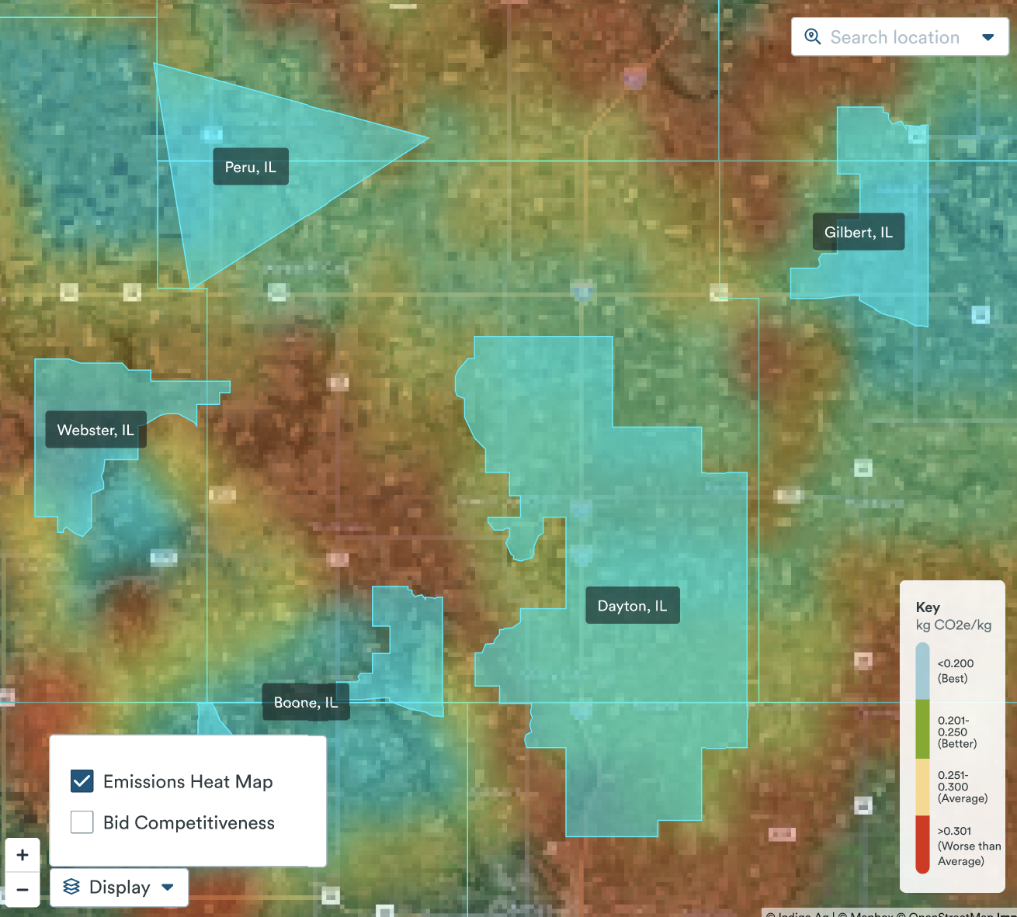
Annual, field-scale predictions allow Indigo to flexibly estimate emissions factors according to brand needs.
Custom Supply-Shed Delineation
Assessment of Facility Supply
Non-SOC Emissions = Pre-Field + Mechanical On-Field +
Non-SOC Soil Emissions
Notes:
Once we have field scale inferences, we can take these annual emissions estimates and, regardless of political boundaries, arrive at an emissions factor specific to the brand supply-shed. On the left we can see an example of a heat map of emissions, red is higher emissions, blue lower, with various examples sourcing regions.
This can, one, help brands understand their current emissions situation. and two
Moving forward, the capability allows us to potentially assist brands in making informed supply-shed decisions that focus on sourcing grain from lower emitting regions.
On the right, we outline non-soc related emissions estimates per bu for 2021 and 2022 for fields within a 30 mile radius of three grain elevators in IL. The x axis is Non-SOC emissions per bu and the y is the relative density of observations of the emissions values.
These figures are comprised of hundreds to thousands of individual field-level observations and we can see that regardless of location, the emissions estimate can vary substantially by field.
We can see that in 2021, regardless of locations, emissions are relatively similar, but in 2022 they diverge. Given the local population of fields in this example, it may be that if given the option, a brand may wish to work with facility A first, before sourcing from B and then C.

Slide 7
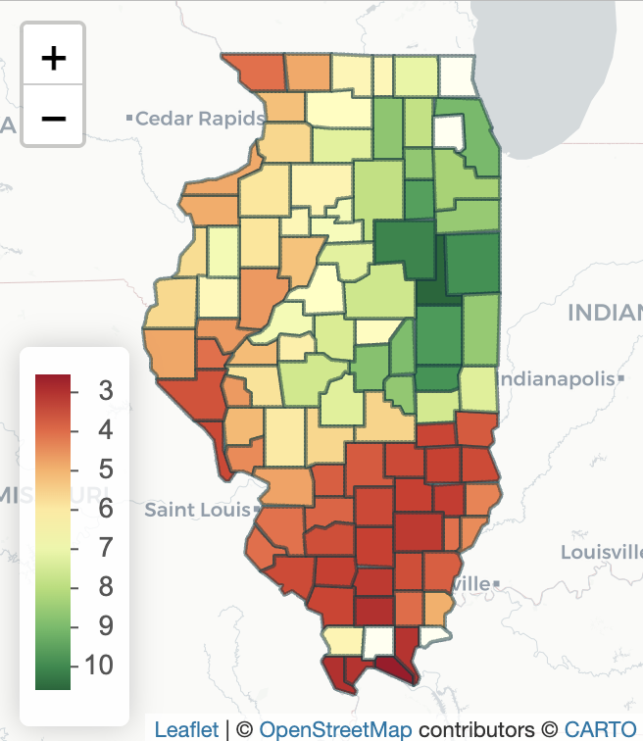
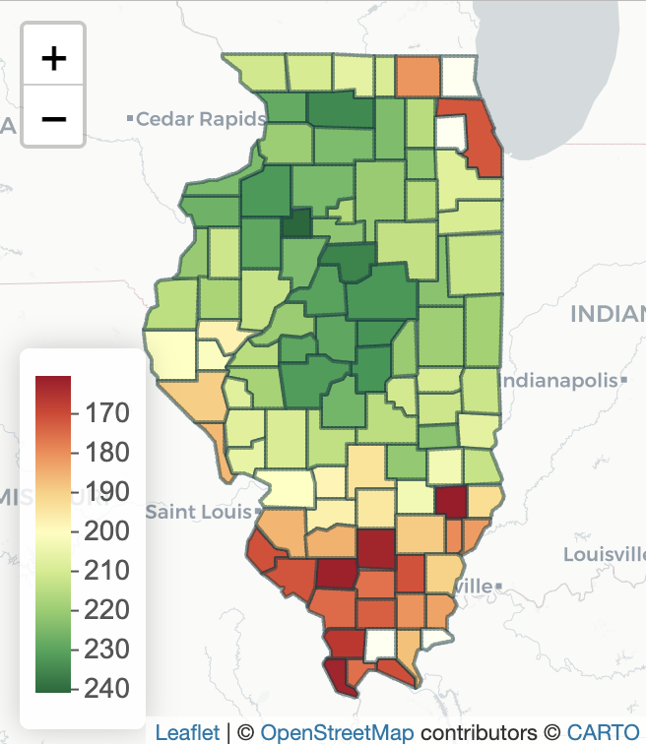
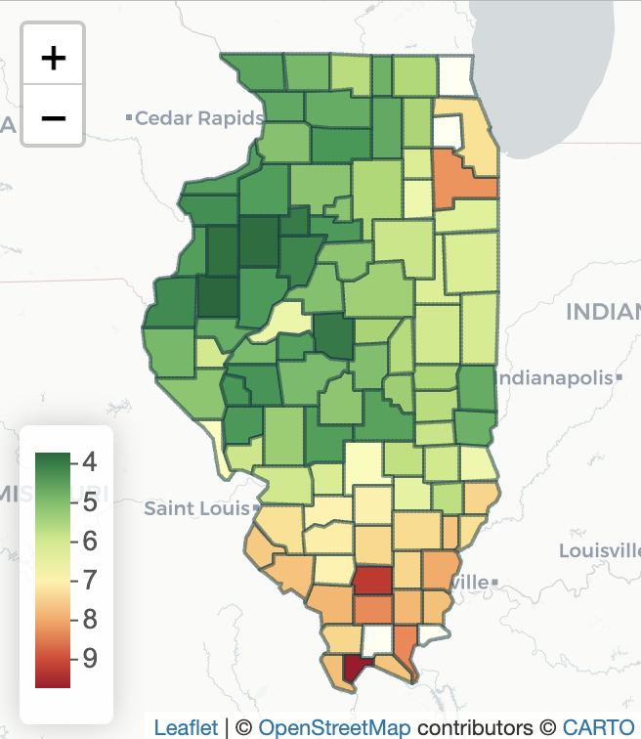
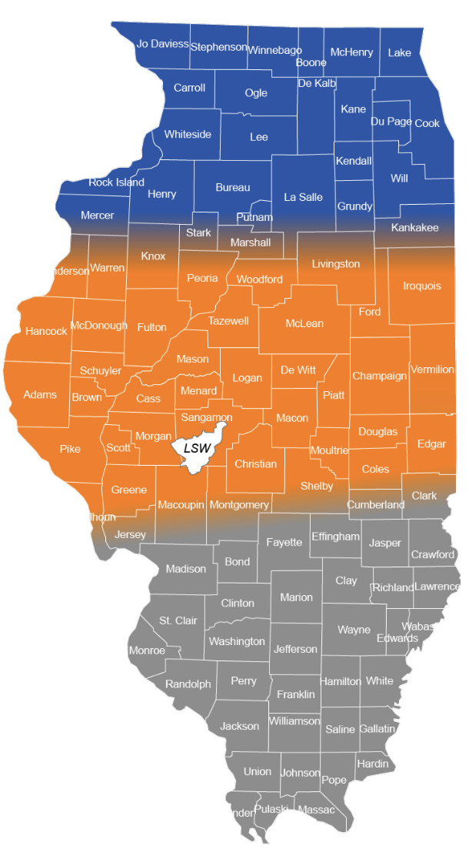
Validation Case Study: Illinois County Summary - Corn - 2022
Higher soil organic carbon (SOC) and yield result in lower total emissions per bushel in the north.
Maximum Return to N (MRTN)
gSSURGO SOC Stock
(kg C per square meter)
USDA-NASS Yield
(bushels per ac)
Non-SOC Emissions
(kg CO2e per bu)
Lower N
Higher N
Source: Corn Nitrogen Rate
Calculator, State Information
Non-SOC Emissions = Pre-Field + Mechanical On-Field + Non-SOC Soil Emissions
Notes:
One question that we often get is how do you know that these emissions estimates are accurate or reliable?
As mentioned previously, we validate our models and approach through a variety of angles to ensure our estimates are as accurate as possible including traditional methods such a test/train splits and k-fold cross-validation.
One important method is to simply ensure that our results make geographic and agronomic sense when coupled with external data to ensure that our training data is not bias in some unanticipated way.
The data coming out of Illinois is a great example of this.
Since we know that fertilizer production and nitrous oxide emissions are a large contributor to total corn emissions, this may be a reasonable place to start
On the left we see that maximum return to N fertilizer recommendation system breaks the state into three distinct management regions. On average, the system tends to recommend higher nitrogen application rates in the south relative to the north. For example, for corn following soybeans in a year with a 10:1 corn:n price ratio, 178 lbs N per acre are recommended in the north vs 200 lbs N per acre in the south.
This is partially due to the fact that soil organic carbon stocks seen in the second tile are generally higher in the north relative to the south. As many of you know, typically, agronomists assume 10-20 lbs N per percent organic matter per year are provide to crops through normal carbon turnover.
Additionally, yields are typically higher in the north due to generally more productive soil and weather conditions.
These factors of lower nitrogen application rates, higher yields, and others often combine to result in lower emissions on a per bushel basis in the north vs. the south and looking at the figure on the right, that’s exactly what our models predict.

Slide 8
Indigo is guiding reductions in Scope 3 agricultural emissions in a cost effective manner through several mechanisms.
EMISSIONS
Establishing a footprint estimate and making informed supply decisions set brands up for success in more active, emissions lowering projects.
Initially, companies may have little to no knowledge of their Scope 3 emissions
Emissions Footprint Measurement provides customers with a custom emission factor for their supply chain, quantified with methodologies that are GHGP and SBTi compliant
Preferential Sourcing Management provides emission factors for suppliers in their value chain, as well as other suppliers nearby whom businesses could potentially source from
Driving Sustainable Outcomes provides project- specific emission factors and helps actively drive reductions in those factors
NET-ZERO
TIME
Notes:
Many of you are probably thinking that this is all well and good but how is Indigo using this information to help brands ultimately reduce their emissions?
We think about this process as a journey.
If the left of the x-axis is today going to a time in the future on the right and the y-axis is total scope three emissions.
At first, a company may not initially know what their emissions footprint is. They are probably currently using a generic emissions factor for say corn in North America.
Through the use of our field-scale predictions, Indigo can quantify what their current supply-shed scope 3 landscape looks. This is our “Emissions Footprint Measurement” product and does not directly contribute to emissions reduction but gives the brand a place to start.
Next, based on the flexibility that the company has, we can start to suggest potential sourcing changes that allow for quick reductions in supply chain emissions. This would be analogous to moving from facility C to facility A in the example on the next slide. While a good first step, this is insufficient to reduce emissions enough to meet net-zero targets.
This information does however help set brands up to pursue more active measures though our Driving Sustainable Outcomes programs where we work directly with farmers to reduce their individual environmental impacts. This is where we would pay farmers to implement practices that specifically are designed to drive their emissions down and hopefully over time can bring the total scope 3 emissions of the brand as close to net-zero as possible.

Slide 9
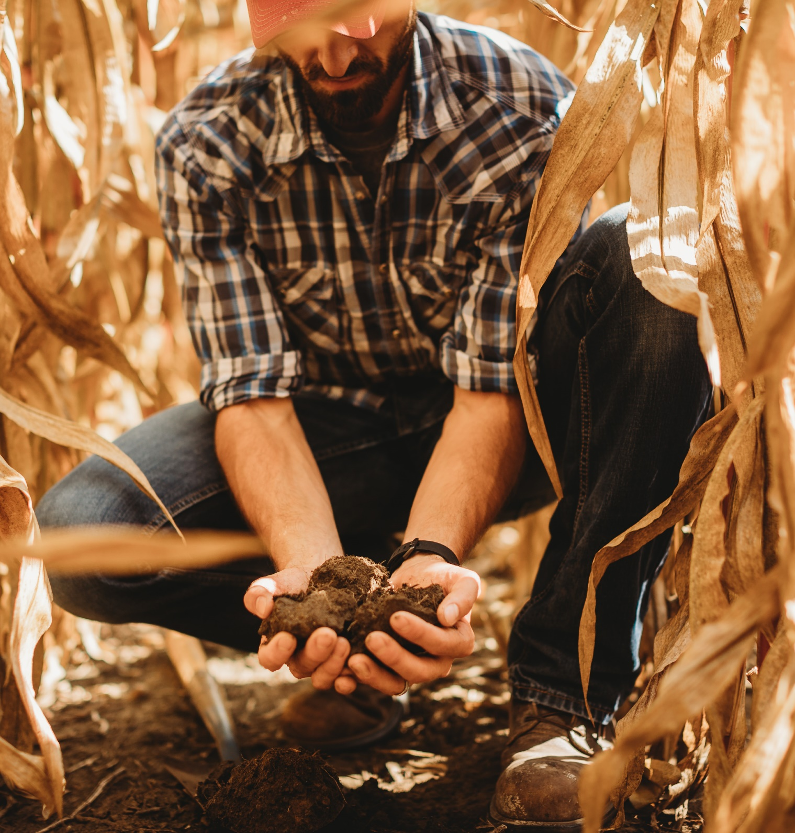
Future Work
Expanding geographies and crops to serve more brand partners.
Improving accuracy
Coupling emissions estimates with grain basis to help agribusinesses navigate the complex sourcing decisions that consider progress towards sustainability goals & optimal pricing.

Slide 10
Thank you! Questions?
Remote Sensing
Nick Malizia
Tina Cormier
Rob Braswell
Doug Bolton
Science
Missy Motew
Hailey Summers
Michelle Schmidt
Hoyoung Kwon
Acknowledgements
Product / Commercial / Policy
Ryan Jones
Alice Chang
Abby Sherburne
Alison Etheridge
Sam Horvath
Data Science
Ben Schulman
Lindsey Gulden
Fernando Tubilla
Engineering
Chad Hawkins
Keith Ma

